Slide 1

CALIFORNIA HOUSING PRICES
Here is where your presentation begins
Group Name: Homeowners

Slide 2
01
02
03
04
FEATURE ENGINEERING
05
MODELING
OUTLINES
INTRODUCTION
DATA PREPROCESSING
EXPLORATORY DATA ANALYSIS (EDA)
06
CONCLUSION

Slide 3

INTRODUCTION
We intend to research housing prices in the state of California based on the data that relates to the houses found in the California district and the summary stats based on the 1990 census data.
Our goal is to create a machine learning model that predicts the price of a given house using the best fit model

Slide 4
DATASET
Features | Description
Longitude | A measure of how far west a house is, a higher value is farther west
Latitude | A measure of how far north a house is, a higher value is farther north
housing_median_age | Median age of a house within a block; a lower number is a newer building
total_rooms | Total number of rooms within a block
Total_bedrooms | Total number of bedrooms within a block
Population | Total number of people residing within a block
Households | Total number of households, a group of people residing within a home unit, for a block
median_income | Median income for households within a block of houses (measured in tens of thousands of US Dollars
ocean_proximity | Location of the house w.r.t ocean/sea
median_house_value | Median house value for households within a block (measured in US Dollars)
Notes:
This project aimed to create a predictor on the California housing dataset.

Slide 5
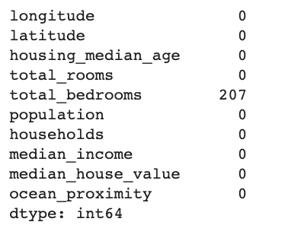
DATA PREPROCESSING
Check The Missing Values
VENUS

Slide 6
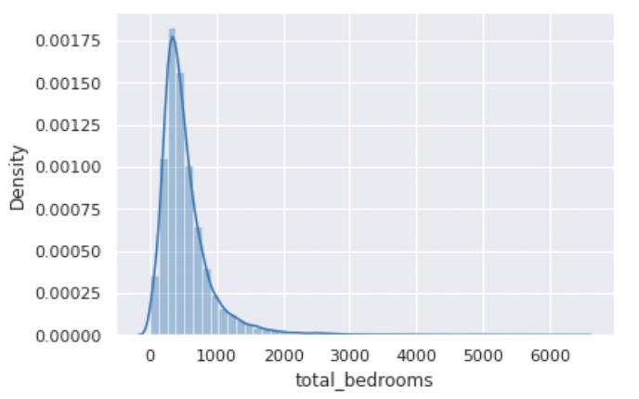
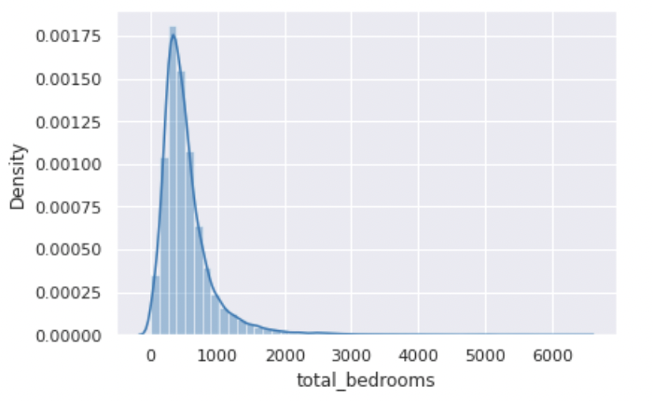
DATA PREPROCESSING
Deal With Totalـbedrooms Column
Fill the missing values using mean()

Slide 7
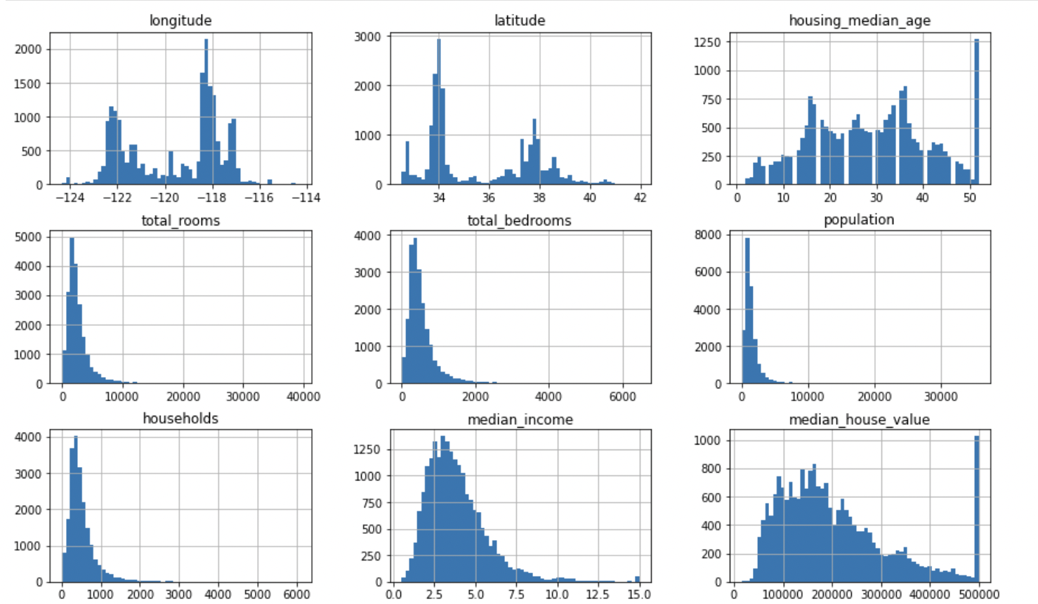
EXPLORATORY DATA ANALYSIS (EDA)
We notice that some the features are right-side skewed
Insert your multimedia content here

Slide 8
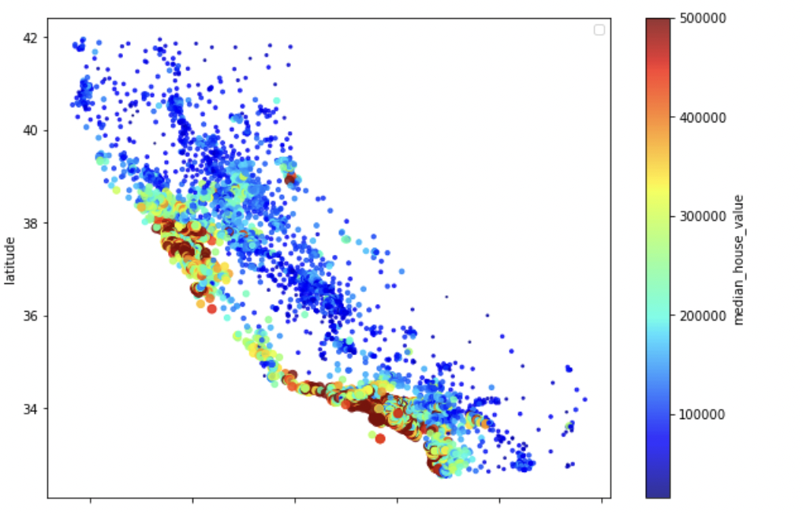
EXPLORATORY DATA ANALYSIS (EDA)
Is the price related to the location?
The locations of houses near the ocean are considered the highest price.
Insert your multimedia content here

Slide 9
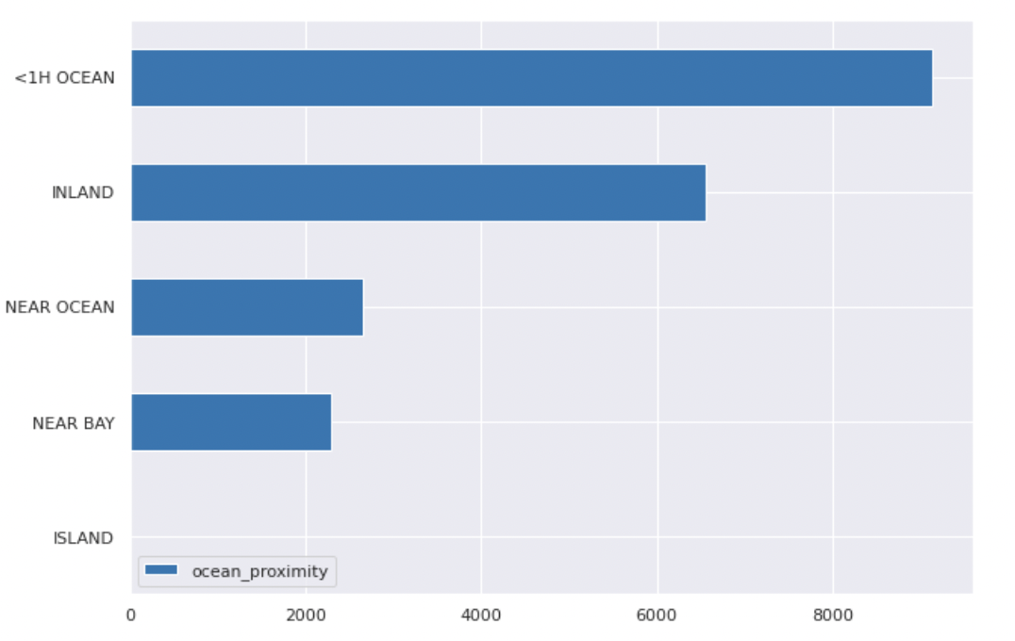
EXPLORATORY DATA ANALYSIS (EDA)
What is the most common place to live?
Most of the houses in our dataset are 1 hour or more away from the ocean and there is almost no houses in Islands
Insert your multimedia content here

Slide 10
Unique Values
Filter out zero or near-zero variance features
FEATURE ENGINEERING
The feature only contains a single unique value or almost unique value that provides no useful information to the model.
We simply delete any features with less than 10% variance.

Slide 11
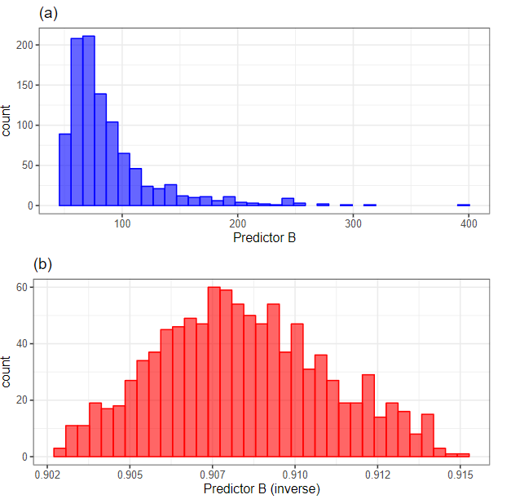
Normalize to resolve numeric feature skewness.
FEATURE ENGINEERING
As we saw in the EDA there are many features that are right skewed so we need to to solve the Skewness and since we have negative values in our dataset we will yeo-johnson to normalizing

Slide 12
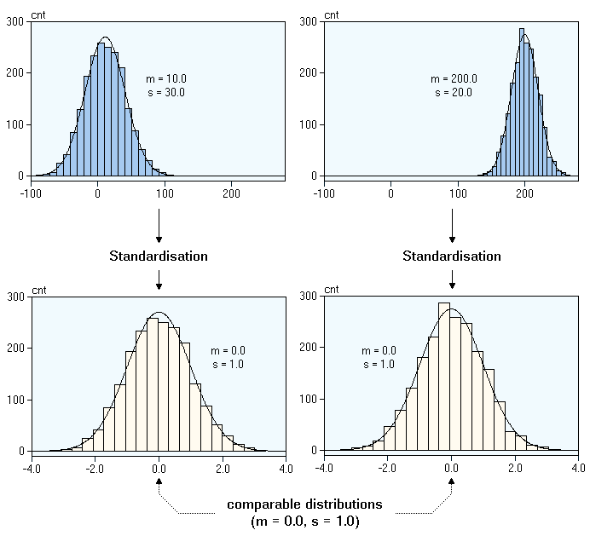
Standardization
FEATURE ENGINEERING
Standardizing features provides a common comparable unit of measure across all the variables.
Notes:
In our example the age of the housing_median_age and the median_house_value

Slide 13
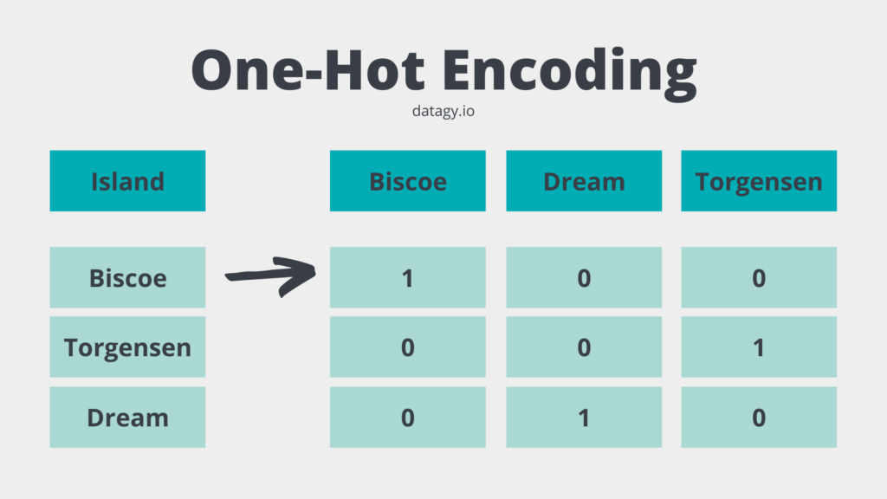
One-hot or dummy encoding
FEATURE ENGINEERING
many ways to recode categorical variables as numeric
For us we chose the one-encoding because since the is only one categorical feature with 5 different values so we will have 5 extra feature
Notes:
In our example the age of the housing_median_age and the median_house_value

Slide 14
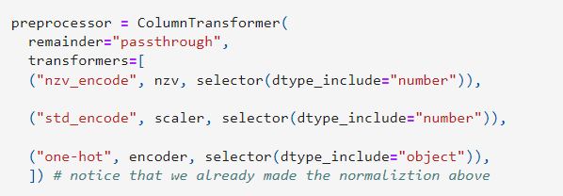
pre-processing pipeline
Putting the process together
FEATURE ENGINEERING
After we do all the nesserly steps we now should combine the steps into pre-processing pipeline

Slide 15


Linear Regression
Random Forest
XGBOOST
MODELING

Slide 16
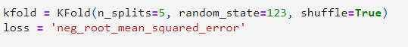
K-fold
In all our model we will use 5 split in the KFold and we will use the RMSE to measure the ERROR rate

Slide 17
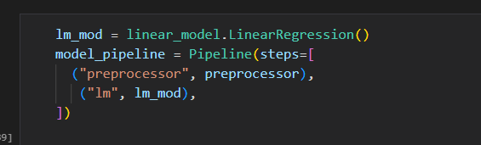
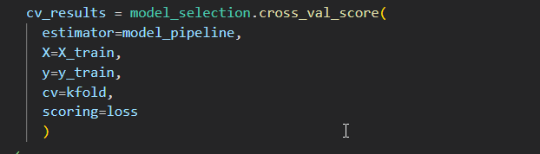
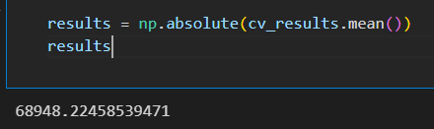
Linear Regression
STAGE 1
STAGE 2
STAGE 3
Create the model and pipeline it into the preprocessing
train and fit the model
The parameter for the model are :
The input to train the model
The target to train the model.
The k- fold
The measure of accuracy which is RMSE
RMSE
We can see that the result is 68940

Slide 18
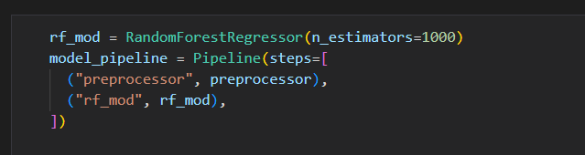
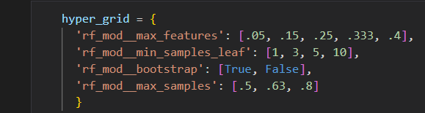
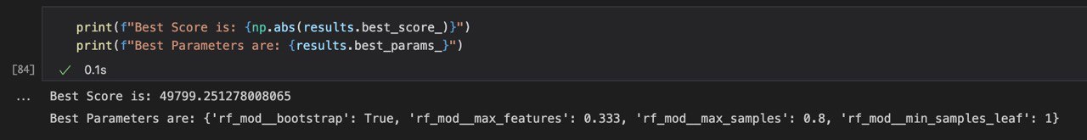
Random Forest
STAGE 1
STAGE 2
STAGE 3
Create the model and pipeline it into the preprocessing
train and fit the model
The parameter for the model are :
Max feature : best split
samples_leaf :minimum samples to be a leaf
- Bootstrap : If False, the whole dataset is used
- max_samples : the number of samples
RMSE score is 49799 which is better than the previous model.
And the best parameters are: True, 0.333, 0.8, and 1 .

Slide 19
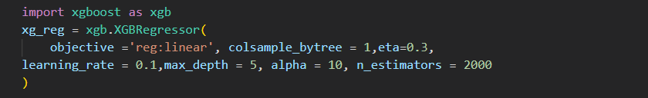
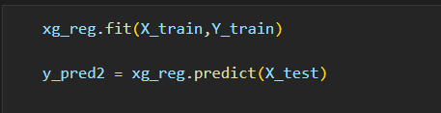
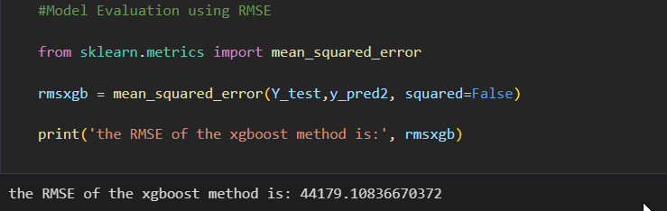
XGBoost
STAGE 1
STAGE 2
STAGE 3
We imported xboost model and set the parameters that we will use
We trained are XGBoost model on the data we split before .
we used RMSE to evaluate the model we used we can see that the RMSE is 44179 which is the lowest of all models

Slide 20
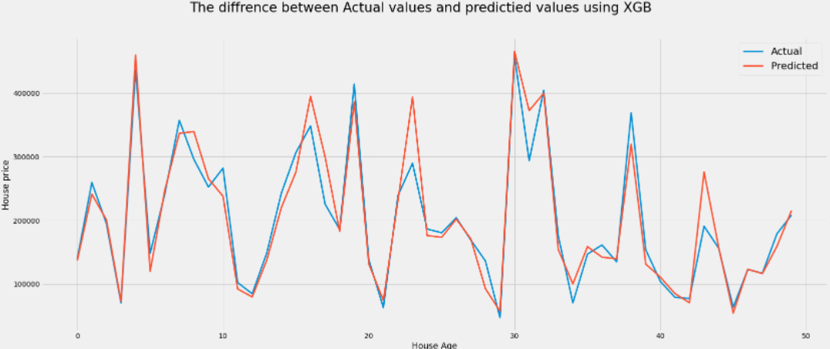
Difference Between Actual Values And Predicted Values
Venus has a beautiful name and is the second planet from the Sun. It’s terribly hot—even hotter than Mercury—and its atmosphere is extremely poisonous. It’s the second-brightest natural object in the night sky after the Moon

Slide 21

THANKS
Does anyone have any questions?
Abdulmalik Alrebdi
Saad AlOtaibi
Shaimaa Alghamdi
Sultan Alharbi

